Slide 1
Checkmate
Project Design
Presented by Esai Jimenez, Autumn Hale, & Trentin Barnhart

Slide 2
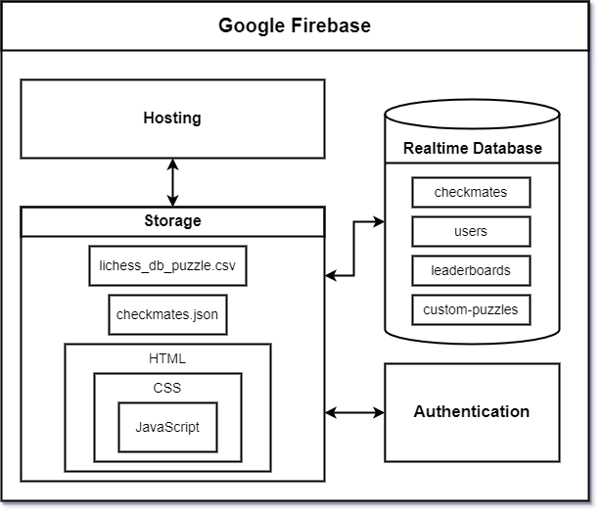
Block Diagram

Slide 3
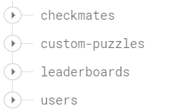
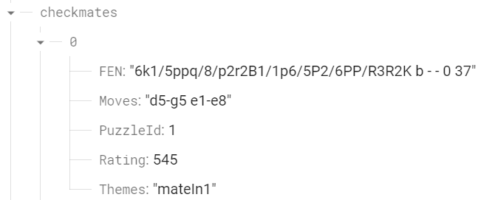
Puzzle
Example

Slide 4
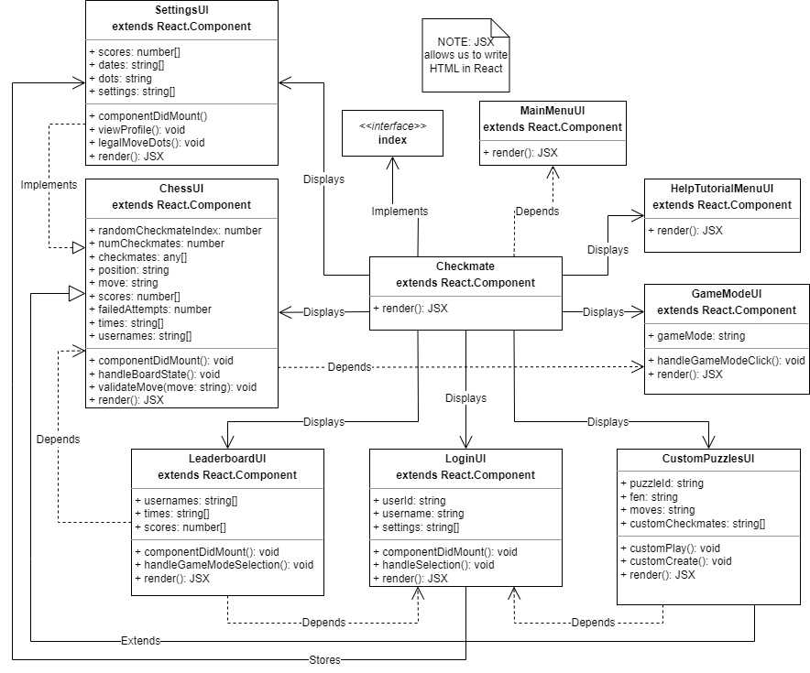
Component Diagram

Slide 5
User Interface Storyboard

Slide 6
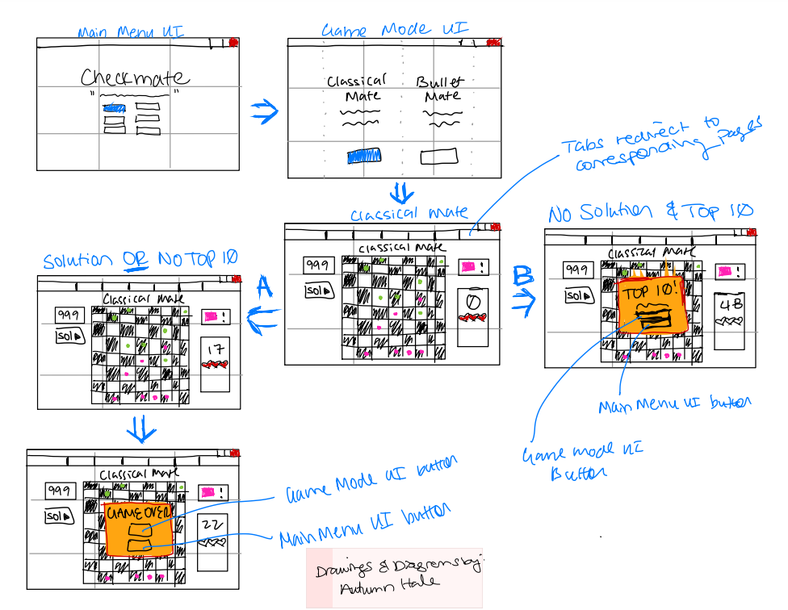

Slide 7
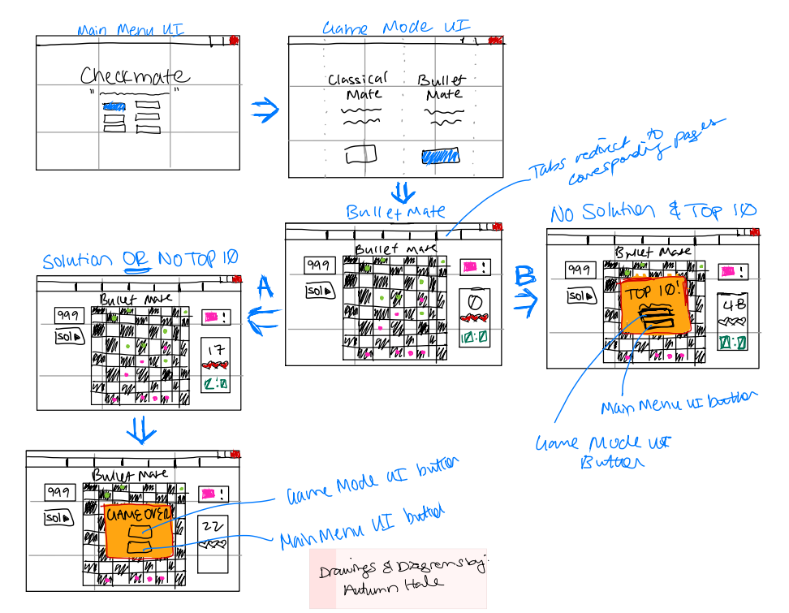

Slide 8
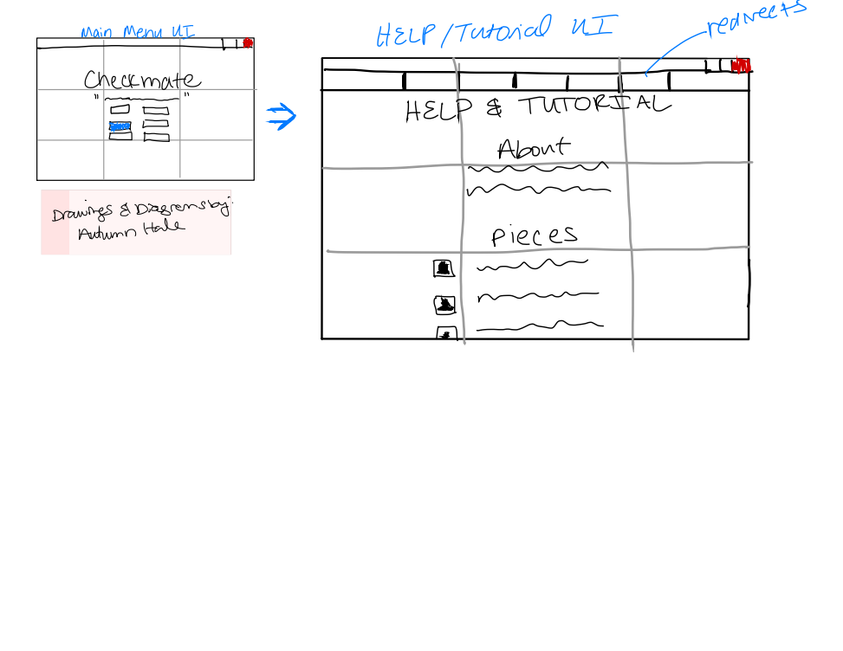

Slide 9
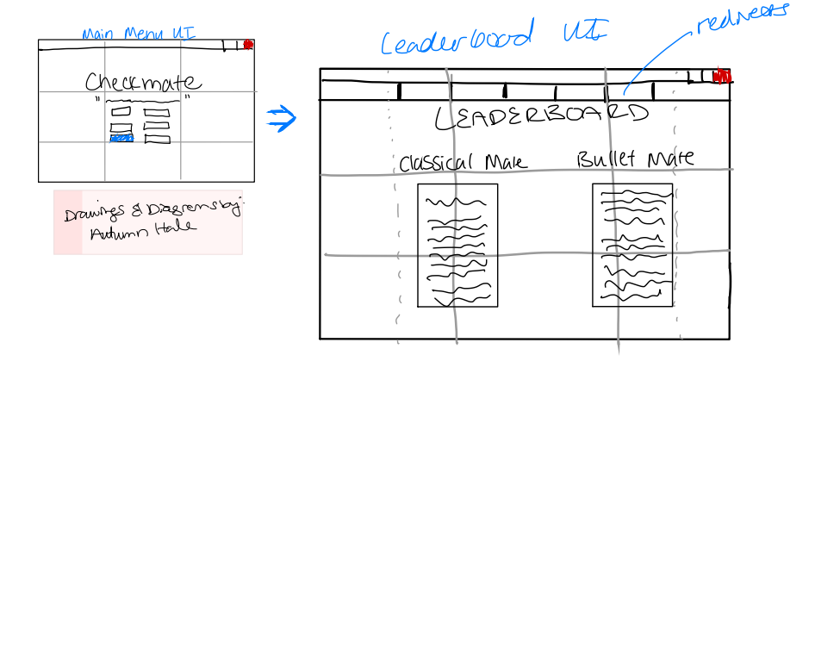

Slide 10
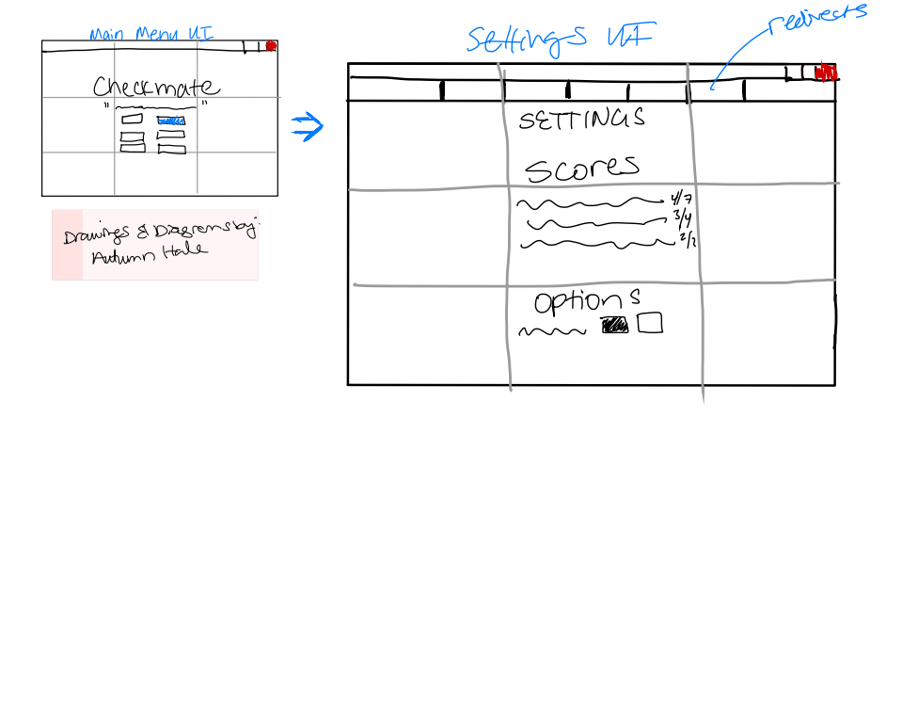

Slide 11
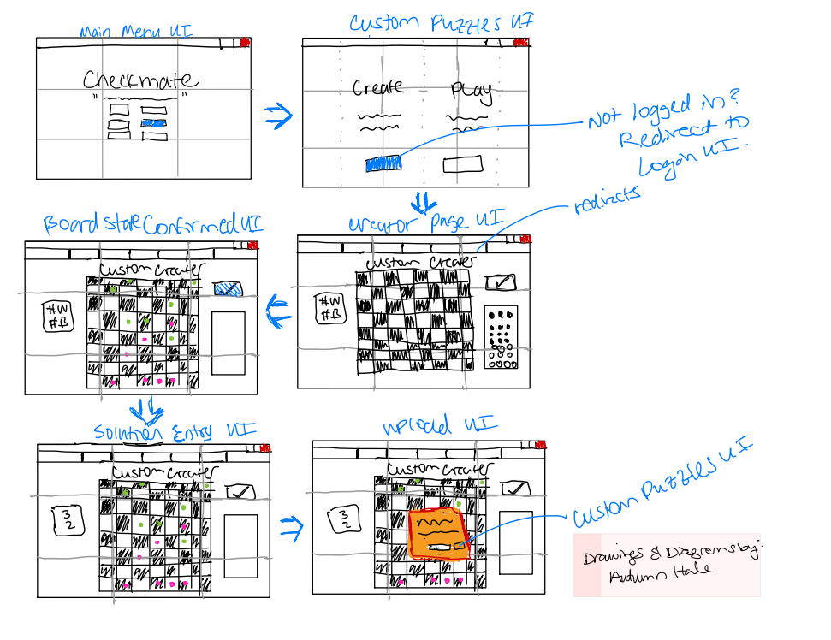

Slide 12
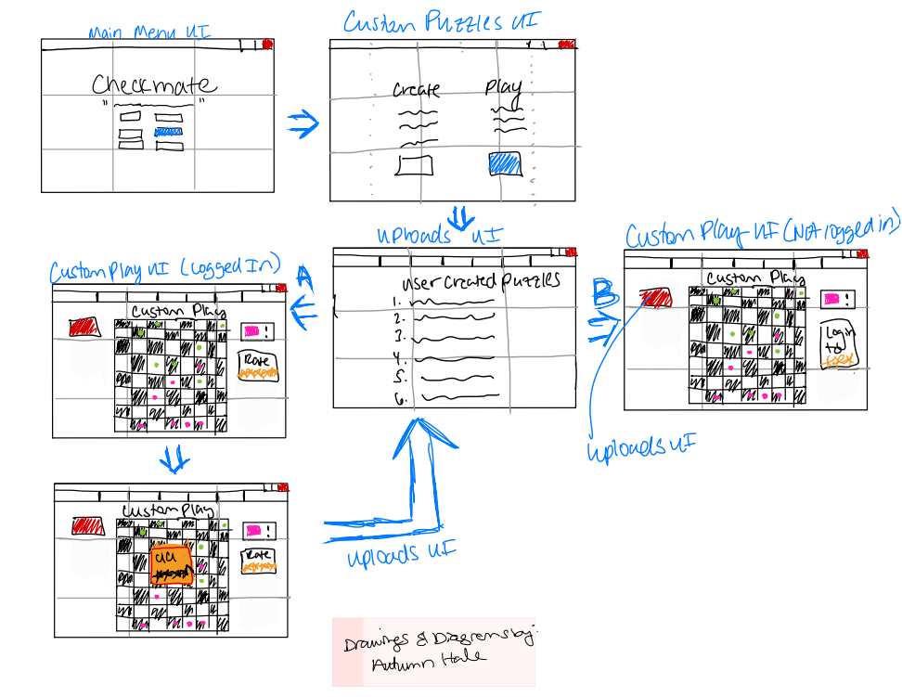

Slide 13
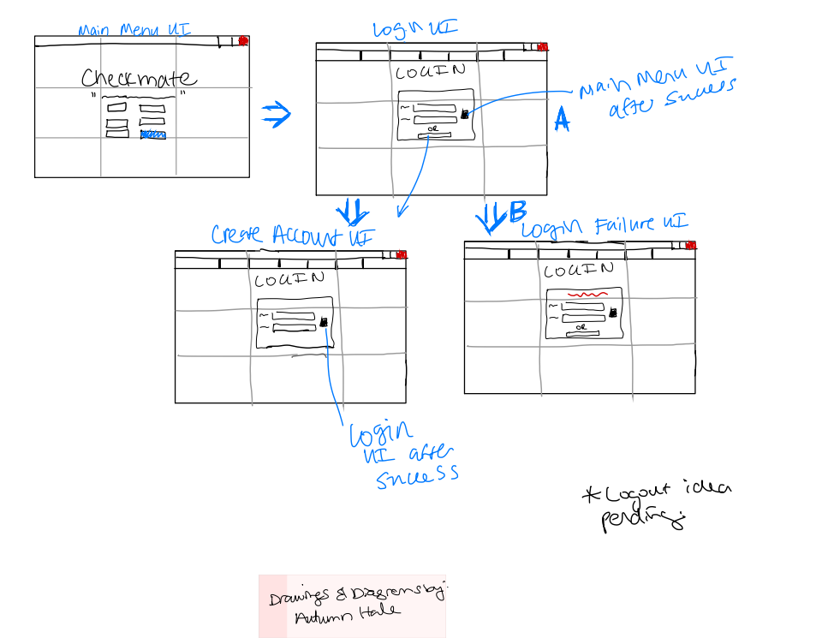

Slide 14
Message Documentation
Retrieve board data
Database to client
FEN, moves, puzzleID, rating, and themes from index
These will be use to populate the board and verify moves for both regular, and custom puzzles

Slide 15
Message Documentation
Send leaderboard data
Client to database
Sends current score, username, and time if applicable
These are used to send a score to the leaderboard and save a user’s past scores for their viewing

Slide 16
Message Documentation
Retrieve leaderboard information
Database to client
Retrieves Usernames (string), Scores (number), and times (time) if applicable from all entries in the current leaderboards
These are used to display the leaderboard info as well as verify if a score should be submitted to the leaderboard

Slide 17
Message Documentation
Send custom puzzle
Client to database
Sends a json with a custom puzzle’s information to be stored in the database
This will be used for other users to play in the custom puzzles menu. (req. 7)
Information includes the board state (string), correct moves (string) and puzzleid (string)

Slide 18
Message Documentation
Retrieve custom puzzle list
Database to client
This will retrieve a list of custom puzzles’ names (string), and rankings (number)
This information will be used to populate the custom puzzle selection window

Slide 19
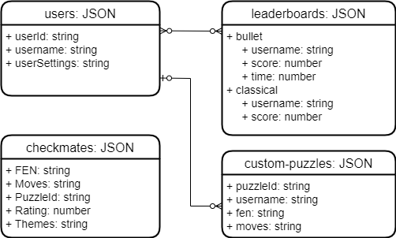
ER Diagram

